Slide 1
Html Css
Beginner course

Slide 2
Objectives

Slide 3
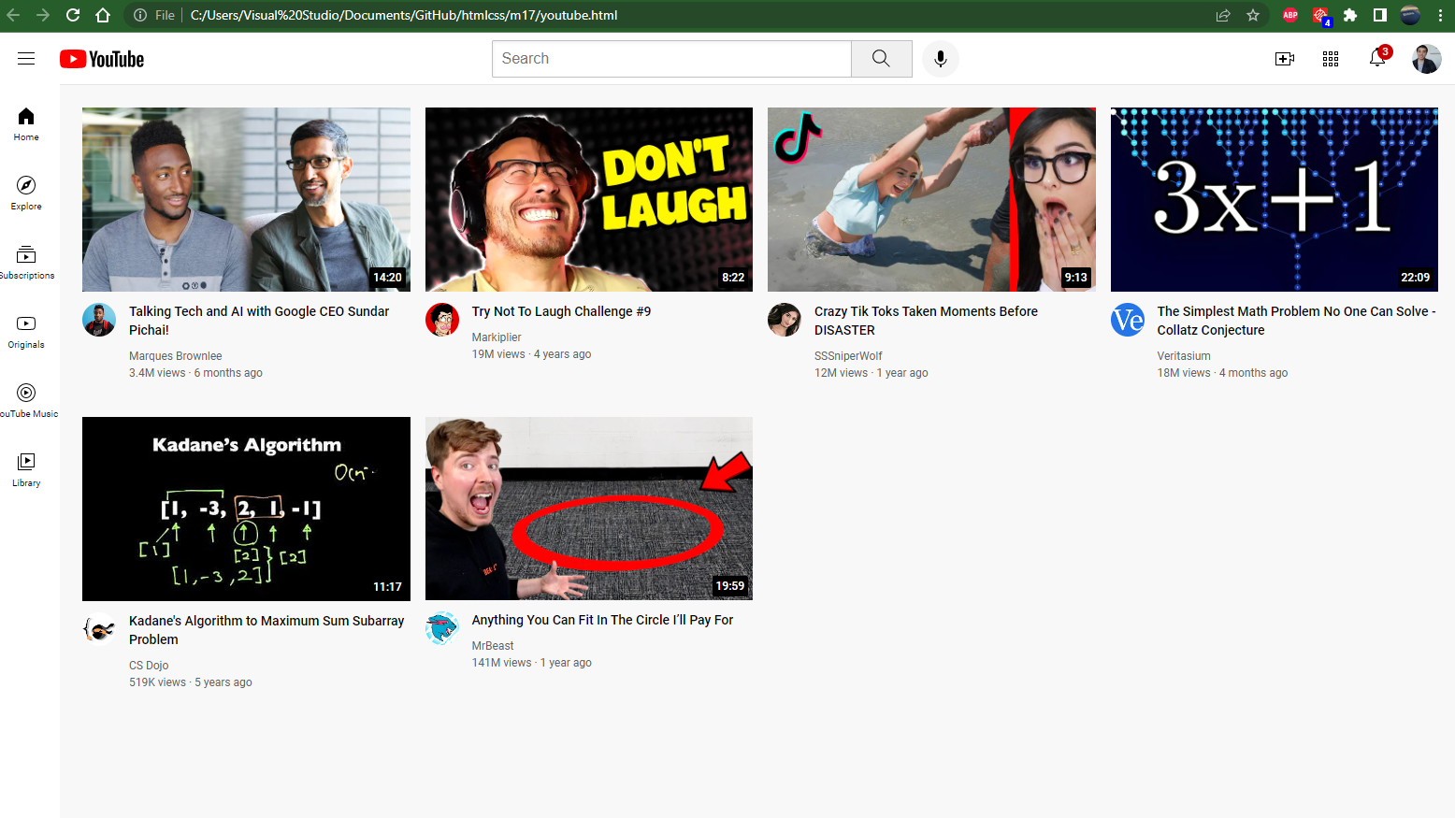

Slide 4
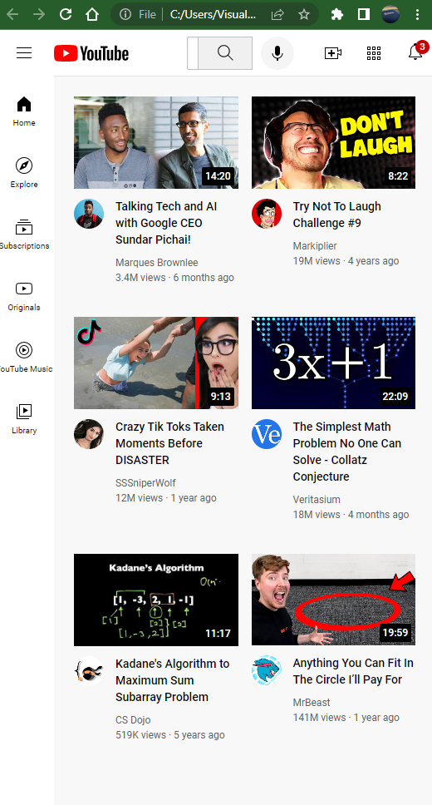

Slide 5
Git & GitHub
Lesson 1 – 06/03/2023

Slide 6
Overview
Install git and create GitHub account
What is git?
How does git work?
What is GitHub?
Quick example using git and GitHub

Slide 7
Install git and create GitHub account

Slide 8
Install git
Windows
https://git-scm.com/download/win
Mac
https://git-scm.com/download/mac
Linux (Debian)
Command: sudo apt-get install git
Linux (Fedora)
Command: sudo yum install git

Slide 9
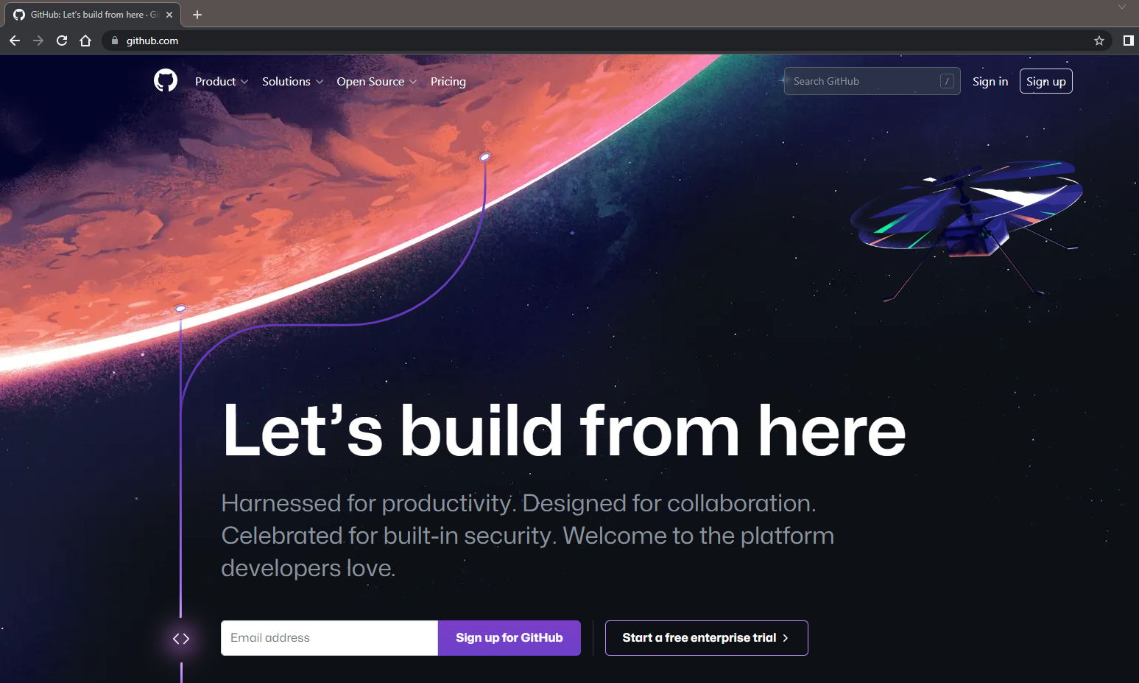
Create Github account
www.github.com
Free for public repositories

Slide 10
What is version control?
A system that keeps record of you changes
Allows for collaborative development
Allows you to know who made what changes when
Allows you to revert any changes and go back to a previous state

Slide 11
What is git?

Slide 12
What is version control?
Distributed version control
Users keep entire code and history on their location machines
Users can make any changes without internet access
(Except pushing and pulling changes from a remote server)

Slide 13

What is git?
Started in 2005
Created by Linus Torvald to aid in Linux kernel development
Git is not the only VCS available (Version Control System)

Slide 14
How does git work?

Slide 15
Key concept: Snapshot
The way git keeps track of your code history
Essentially records what all your files look like at a given point in time
You decide when to take the snapshot and of what files
Have the ability to go back to visit any snapshot

Slide 16
Key concept: Commit
The act of creating a snapshot
Essentially, a project is made up of a bunch of commits
Commits contain 3 important pieces of information
Information about how files changed from previously
A reference to the commit that came before it (called the “parent commit”)
A hash code name (looks something like: 228e4aa843326f69ef6fb486dc3a0dd27680f156)

Slide 17
Key concept: Repository
A.k.a “repo”
A collection of all the files and the history of those files
So, it consists of all you commits
Place where all your hard work is stored ☺
Can live on a local machine (your notebook) or on a remote server (GitHub)
The act of copying a repo from a server to your notebook is called “cloning”
Cloning from a remote server allows teams to work together

Slide 18
Key concept: Repository
The process of downloading commits that do not exist on your notebook from a remote repository is called “pulling” changes
The process of adding your local changes to the remote repository is called “pushing” changes

Slide 19
Key concept: Branches
All commits in git live on some branch
There can be many many branches
The main branch in a project is called master branch (or main branch)

Slide 20
Example

Slide 21
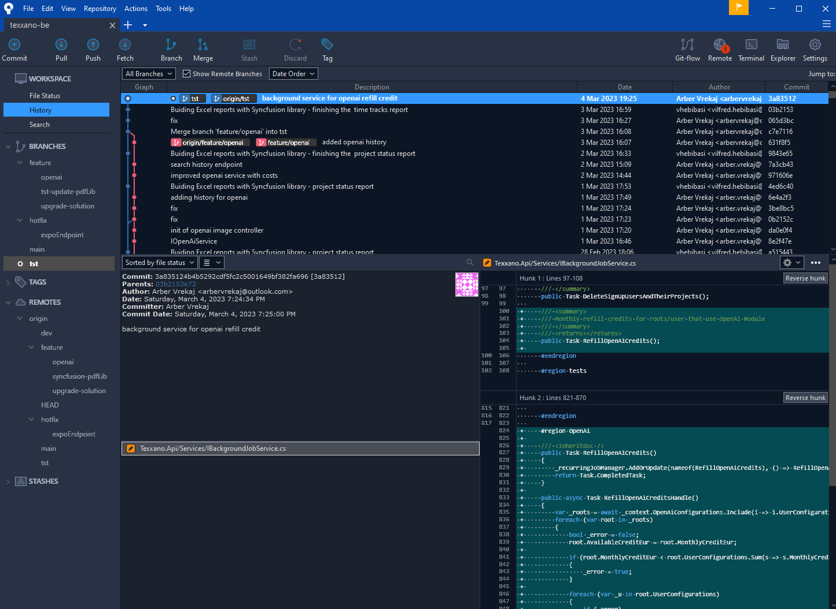

Slide 22
How to make a commit?
Make changes to a file
Use the “git add” command to put the file onto the “staging environment”
Use the “git commit” command to create a new commit

Slide 23
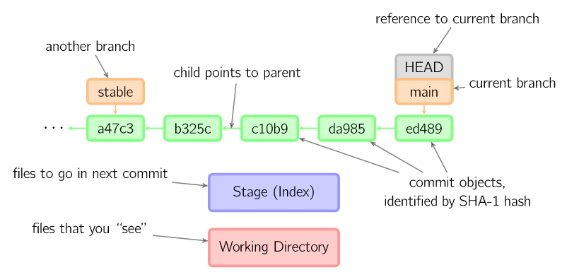
How to make a commit?

Slide 24
What is GitHub?

Slide 25

What is GitHub?
www.github.com
Largest web-based git repository hosting service
Allows for code collaboration with anyone online
Adds extra functionality on top of git such as: documentation, bug tracking, nice UI, feature requests, pull requests, etc
Founded in 2008
Also has an Enterprise edition for businesses

Slide 26
Demo

